Slide 1
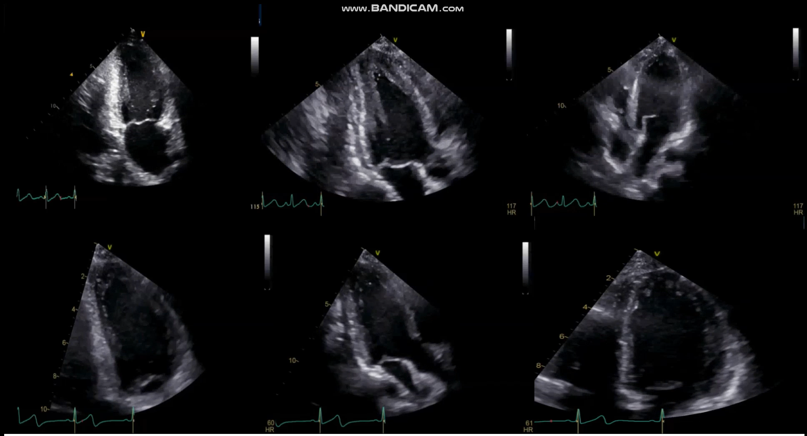
(a)
(b)
(c)
(d)
(e)
(f)
Supplement (1): TTE . The upper row shows apical hyperkinesia with basal and mid segment akinesia with severely reduced LV EF, (a)Two chambers view, (b) Three chambers view, (c) four chambers view. lower row shows improvement of LV EF and resolution of regional wall abnormalities , (d) Two chambers view, (e) Three chambers view, (f) four chambers view.

